Slide 1

AtliQ Sales Insights
Ad-Hoc Insights
Presented By : Mahi Agarwal

Slide 2
Contents
About the Company | 3
About Objectives | 4
Company’s Market | 5
Ad-Hoc Analysis | 6-15

Slide 3

About the Company
AtliQ Hardware is a Computer Hardware and Accessory Manufacturer
The Company manufactures product under 3 major divisions i.e., Networking and Storage, PC, Peripherals and Accessories
AtliQ Hardware is operational in NA, LATAM, EU and APAC regions

Slide 4

Objectives
AtliQ Hardware is one of the major computer hardware manufacturers in India, with a strong presence in other nations.
Nevertheless, the management did note that they do not have sufficient insights to make prompt, wise, and data-informed judgments.
Plan to expand the data analytics team by adding junior data analysts.
The company seeks insights for 9 ad hoc requests.
To assess candidates, Data analytics director, Tony Sharma plans to conduct a SQL Challenge to evaluate both tech and soft skills.

Slide 5
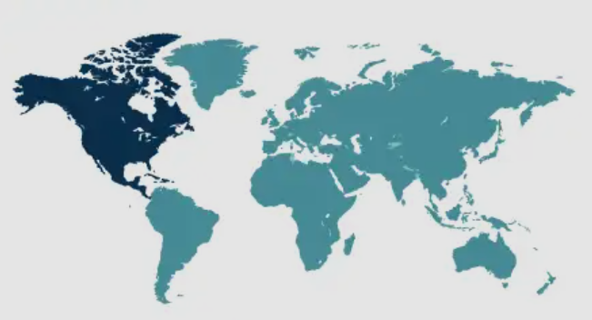
Company’s Market
AtliQ Hardware operates across four major regions: North America (NA), Latin America (LATAM), Europe (EU), and Asia Pacific (APAC). This global presence allows AtliQ to serve diverse customer needs with products in Networking and Storage, PCs, Peripherals and Accessories.
In NA and EU, AtliQ benefits from strong demand for Advanced Computing Solutions. LATAM and APAC, with their growing economies, offer Significant Opportunities for Expansion. This strategic positioning ensures AtliQ's sustained growth and customer satisfaction worldwide.

Slide 6
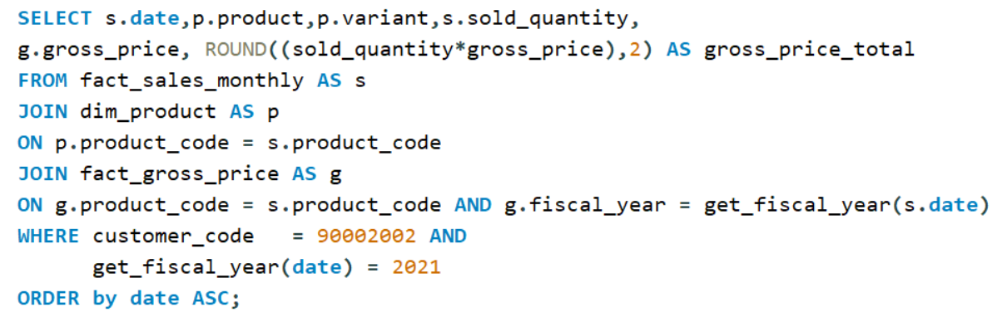
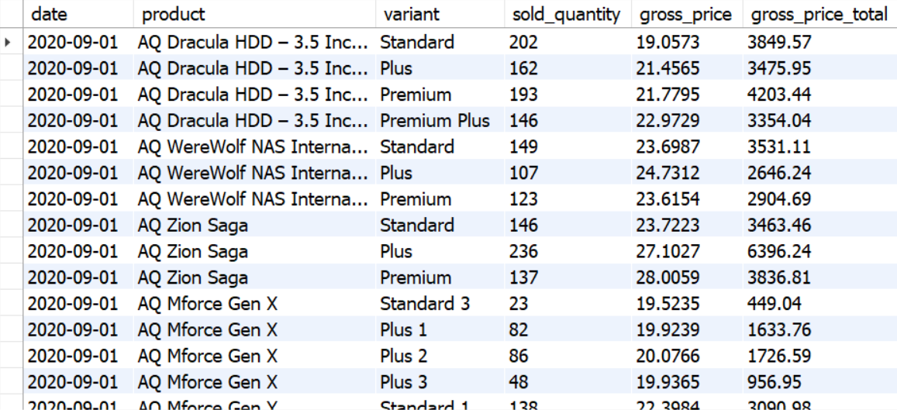
Provide a sales report for Croma India for the financial year 2021, including all products, their variants, quantities sold, and total gross revenue.
Key Insights
The AQ Dracula HDD (Standard Variant) contributed ₹3,849.57 in total gross revenue during FY 2021.
A total of 202 units were successfully sold, reflecting consistent demand for mid-range internal storage solutions.

Slide 7
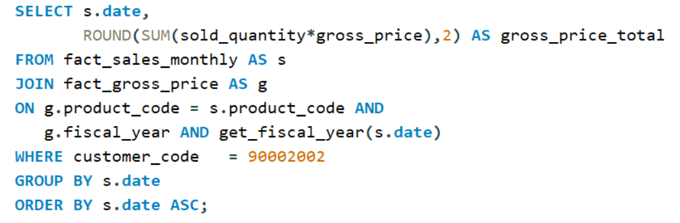
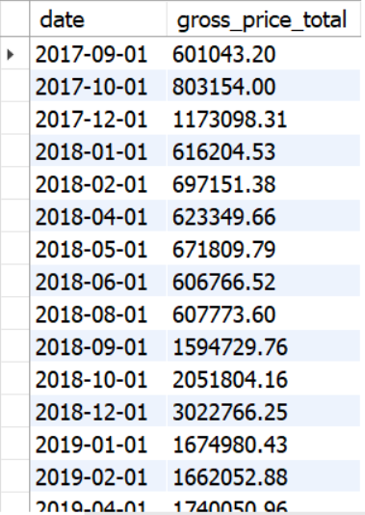
2) Provide an aggregated monthly gross sales report for Croma India.
Year
Maximum Monthly Gross Revenue
2017
2018
2019
2020
2021
1,173,098.31
3,022,766.25
5,629,655.65
12,553,037.40
53,116,138.93
Gross revenue shows a consistent upward trend from 2017 to 2021.
The most significant increase occurred between 2020 and 2021, where maximum monthly revenue surged from ₹12.55 million to ₹53.11 million.
Such growth indicates strong market expansion and improved sales performance across product categories.

Slide 8
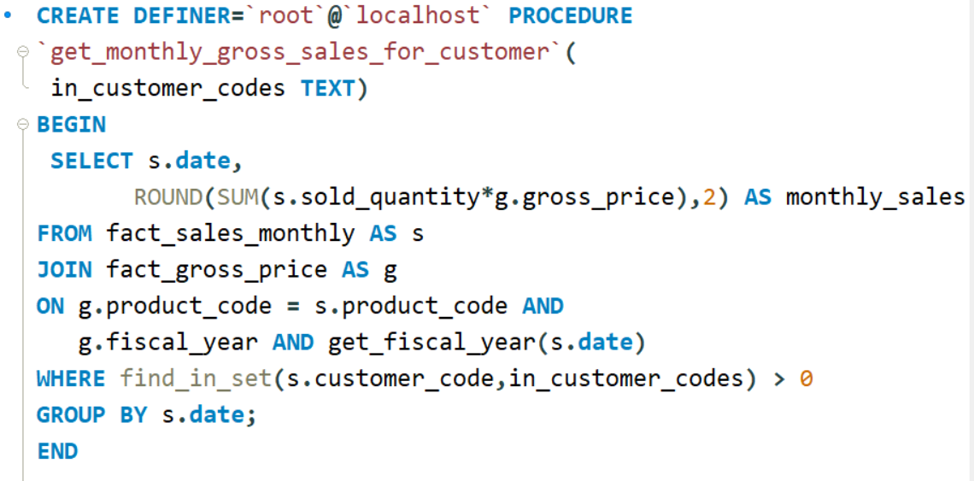
3) Create a stored procedure for monthly gross sales report.
To avoid repeatedly running the same SQL query every time we need the monthly gross sales figures, we created a stored procedure that automates the entire process. Instead of manually calculating the monthly totals for each year, the stored procedure fetches, aggregates, and returns the monthly gross sales in a single execution.

Slide 9
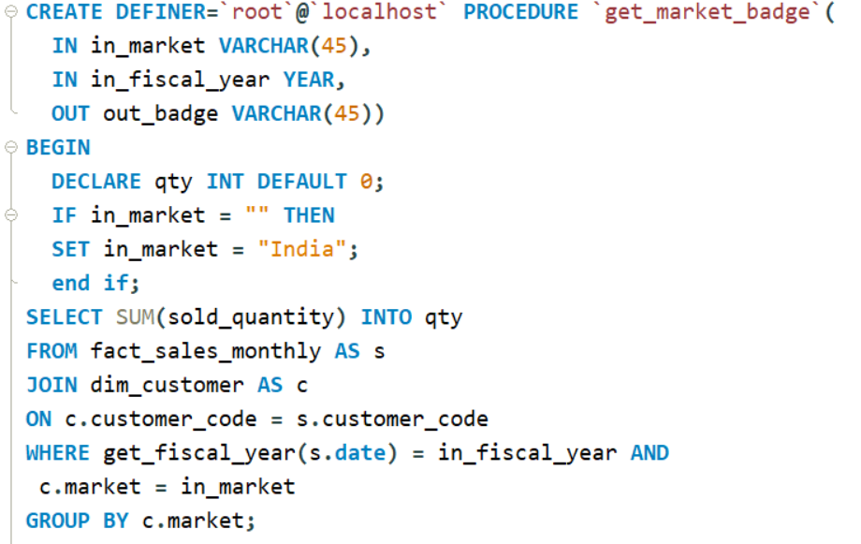
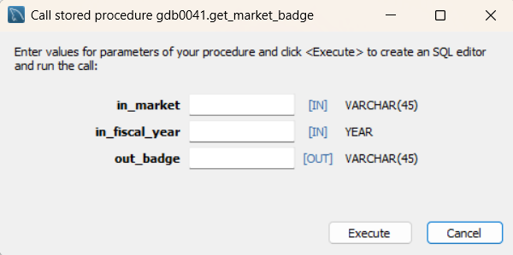
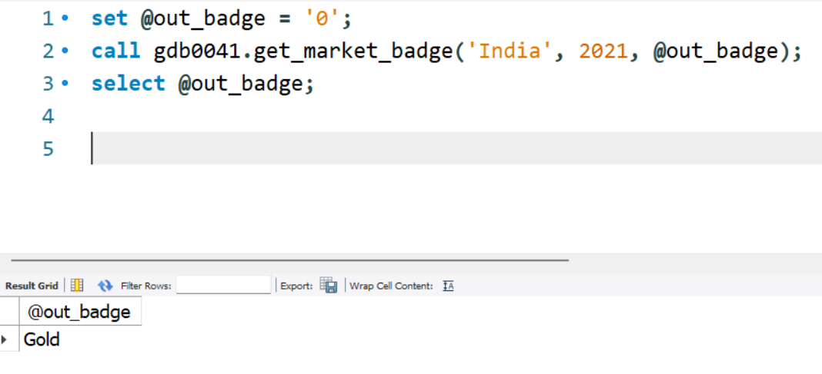
4) Create a stored procedure to determine the market badge. If the total sold quantity is greater than 5 million, the market should be considered Gold; otherwise, it should be considered Silver.
A stored procedure is created to assign a market badge based on total sold quantity. If sales exceed 5 million units, the market is marked Gold; otherwise, it receives Silver
.
For example, in FY 2021, India crossed the 5-million mark and therefore received a Gold badge.

Slide 10
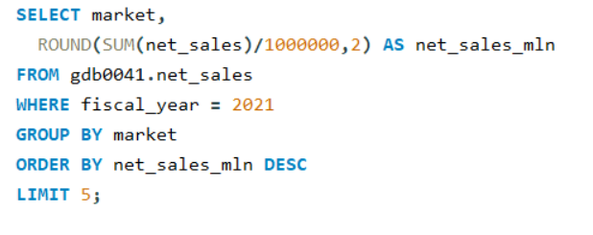
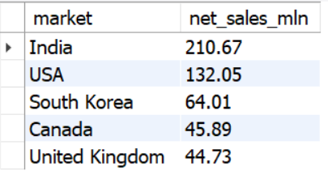
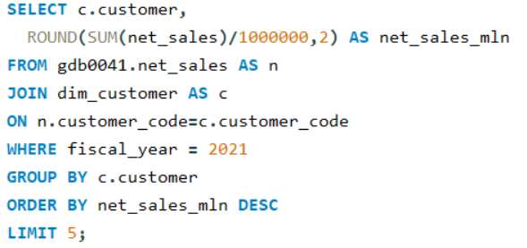
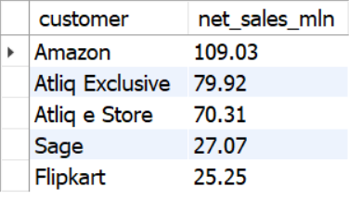
5) Identify the top market, top selling products, top customers based on net sales.
Top Market: India with net sales of ₹210.67
Top Market
Top Customer
Top Customer: Amazon with net sales of ₹109.03

Slide 11
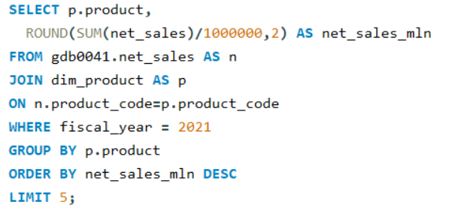
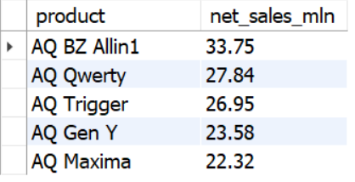
Top Product: AQ BZ Allin1 with net sales of ₹33.75
Top Product

Slide 12
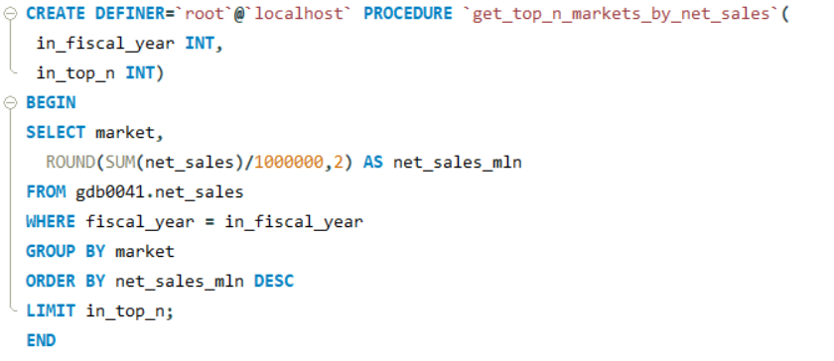
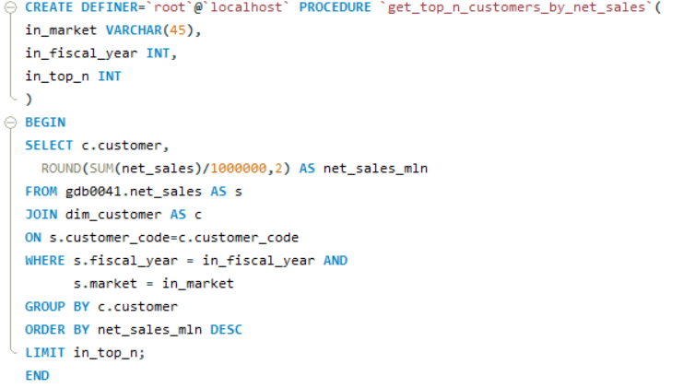
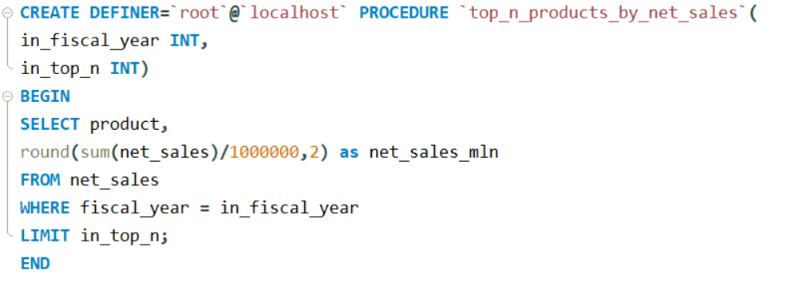
6) Create a stored procedure to return the top N markets, customers, products based on net sales.
A stored procedure is created to quickly return the top N markets, customers, and products based on net sales. This eliminates the need to manually write separate SQL queries each time and provides an easy way to fetch the highest-performing markets, customers, or products instantly.

Slide 13
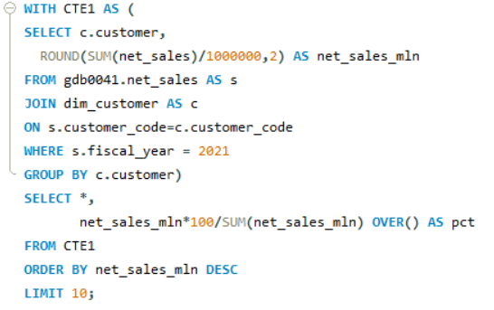
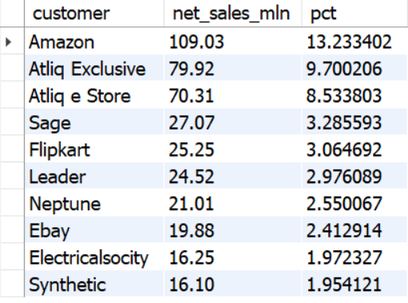
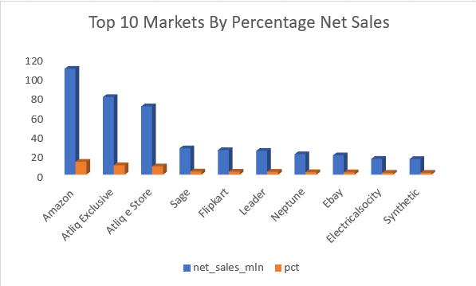
7) Provide a bar chart report for the top 10 customers based on percentage net sales for the financial year 2021.
Amazon emerges as the top customer with net sales of ₹109.03 million, representing 13.23% of the total net sales. Atliq Exclusive follows in second place with a 9.7% share, while Synthetic ranks lowest among the top 10, contributing 1.95% of net sales. The chart provides a clear view of each customer’s contribution, making it easy to identify the major revenue drivers.

Slide 14
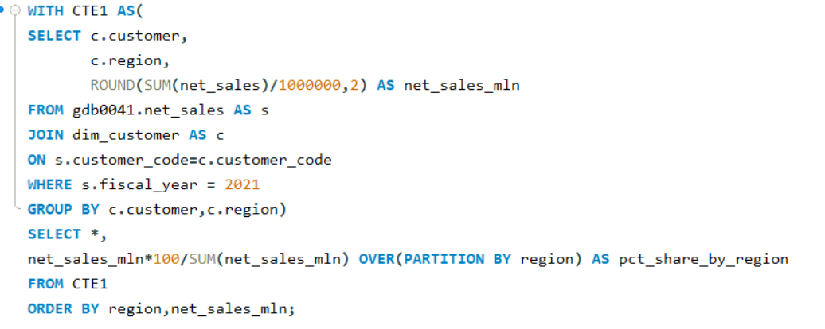
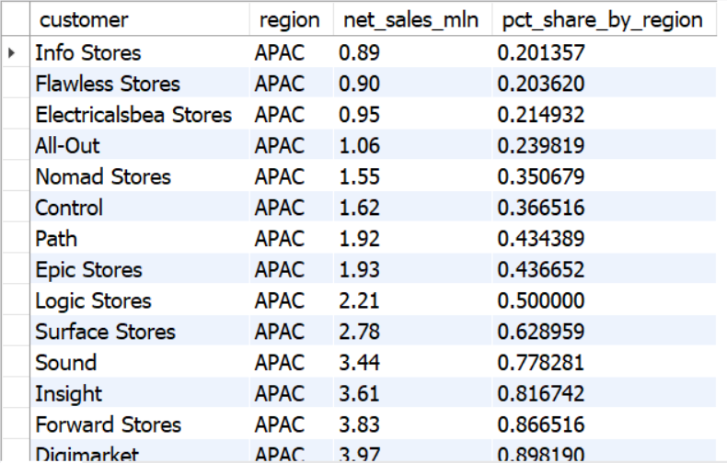
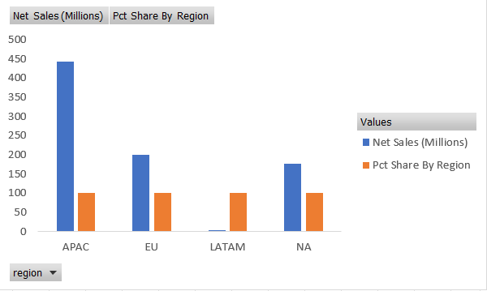
8) Provide a region-wise percentage net sales breakdown by customers for the financial year 2021.
In the APAC region, Amazon accounted for 12.99% of net sales. In the EU, Atliq e Store led with a 9.87% share. For LATAM, Amazon dominated with 48.73%, while in North America, Amazon contributed 17% of the region’s net sales.

Slide 15
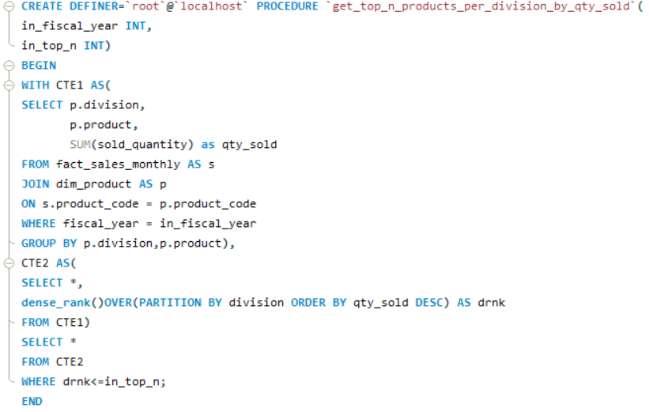
9) Create a stored procedure to identify the top N products in each division based on quantity sold for a given FY such as 2021.
A stored procedure is created to identify the top N products in each division based on quantity sold for a given financial year, such as 2021. This automates the process and makes it easy to retrieve the top-performing products without manually running multiple queries.

Slide 16
Thank You

